Slide 1
UNCLASSIFIED –cleared for public release
ORS Program Status
1May 2012
Space-based Lidar Winds Working Group
Miami FL
Thomas.Adang@kirtland.af.mil
505-846-3115
Distribution A: Cleared for Public Release
UNCLASSIFIED – Cleared for Public Release --- PA Case 2012-0235

Slide 2
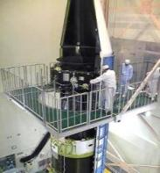
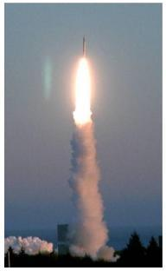
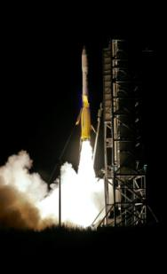
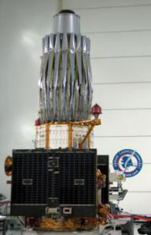

Four Years Four Launches
UNCLASSIFIED – CLEARED FOR PUBLIC RELEASE
ORS Office Established : May 2007
July 2008
1st Rapid Transport & Integration
JUMPSTART Demo
May 2009
1st Tactical
HSI
AFRL’s TacSat-3
Jun 2011
1st Dedicated COCOM ISR
ORS-1
Sep 2011
1st Comm-on-the-Move
NRL’s TacSat-4
Wallops Flight Facility/ MARS
Wallops Flight Facility/ MARS
6 Day Call Up
To
Launch
Transitioned to Operations
June 2010
Transitioned to Operations
Jan 2012
Demo Modular Bus Standards
& Military Utility
Rapid Development – Relevant to the Warfighter
UNCLASSIFIED – CLEARED FOR PUBLIC RELEASE
Notes:
Since the Office stood up in May 2007, we have delivered capabilities to the warfighter by using novel approaches and leveraging what already exists and closing collaborating with the community. These are amazing successes in a budget constrained environment. The successes will be highlighted more throughout this talk.

Slide 3

















ORS Office Objectives
Two Primary Tasks:
Develop End-to-End Enabling Capabilities
Respond to Joint Force Commanders’ Needs
Kodiak Launch Complex
MMSOC
Rapid Assembly, Integration and Testing (AI&T)
NASA Wallops
Mid Atlantic Regional Spaceport
Minotaur Family of Launch Vehicles
Virtual Mission Ops and Control
Modular Open Systems Approach
Plug-n-Play Technologies
Cape Canaveral
Super Strypi
Tactical TPED
Common Data Link
Vandenberg AFB
Responsive Command & Control , Tasking, Processing, Exploitation & Dissemination
Responsive
Buses/Payloads & Manufacturing
RAPTOR
Responsive Launchers
Responsive Ranges
Kwajalein
Notes:
As directed by the Commander of Strategic Command, the ORS Office has two overarching objectives,
1. To build the enabling infrastructure and CONOPs necessary to deploy existing capabilities in weeks and new capabilities in less than a year And --
2. To respond to the urgent needs of the JFCs
To achieve these timelines we are developing the infrastructure to deliver capabilities to the warfighter quickly by using an open innovation process that focuses on a modular open systems approach that encompasses the following:
PnP Buses and Modular payloads
- Having launch assets waiting or quickly configured
- Having ranges that are interoperable, space-based and adaptable to unforeseen events
- And, embracing new concepts of operations
Our approach builds the enabling infrastructure to respond to the critical and unanticipated needs of the warfighter in operationally relevant timelines. I’m going to step through specific examples and concepts to achieve this end state.
3

Slide 4















Rapid Response Space Works Operations Focal Point for Rapid Development
Threats
and Need
Plan and
Mission Design
Design, Space Qualification
AI&T
Deliver
Booster
AI&T
Launch
Operate,
Sustain
Payloads
Flight System
Need All Weather, Day/Night Coverage in Theater X
Bus Modular Components
RRSW GDS
RRSW Ops
RRSW is the Focal Point for Satellite and Mission Design and Assembly
Change Agent for Responsive and Affordable Space
NRE Cost and Time Driven Down
Technical Competency Increased
Mission Assurance Increased
Modern Manufacturing Techniques
STRATCOM ORDERS A SPACE NEED—RRSW BUILDS IT AND DELIVERS IT
Components Provided to RRSW by Contractors Based on Need and Response Time
Payloads
Bus Modular Components

Slide 5
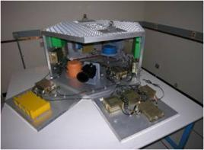
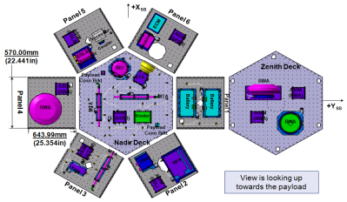
ORS-2: Tier-2 Enabler Mission
1st End-to-End Demonstration of a Modular, Reconfigurable System
Mission Goals:
Develop multi-mission bus architecture: Standards-based, modular, rapidly configurable
Develop multi-mission payload architecture: Establish beginning of RF family of payloads (Radar, Comm, Electronic Tactical Support)
Develop end-to-end modular satellite vehicle processing
Demonstrate End-to-End architecture to include satellite system, ground systems architecture and innovative processes
MSV Testbed
Status:
Modular Space Vehicle (MSV) Bus PDR - Complete FY11
MSV Bus CDR: FY12
Modular Payload: PDR FY12
Rapid Response Space Works Stand Up: FY11

Slide 6
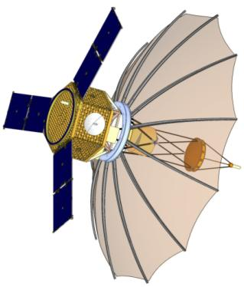
ORS-2: Space Vehicle Overview
Low Earth Orbit
500 km @ 45 degree inclination
1 year mission life, 18 month goal
No propulsion
Synthetic Aperture Radar (SAR) Payload
Capable of taking SAR strip-map and spot imagery
Capacity scaled to a COCOM
ORS-2:
Space Vehicle
Unclassified Cleared for Public Release

Slide 7







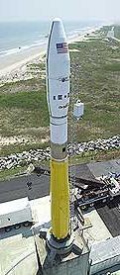
Unclassified Cleared for Public Release
ORS-3: The ORS Enabler Mission
Ushering in Launch and Range Processes of the Future
Approach
Use Automated Launch Vehicle Orbital Targeting Process
Use Automated Range Safety Planning Process
Develop Autonomous Flight Safety System – Significant Launch and Range O&M cost reductions
Use CubeSat Wafers – Allows secondary payload capability taking advantage of excess lift capacity that is benign to primary payload
Results:
Commercial Like Launch Procurement and Execution
~$24M Fly Away Cost
FAA
License
Specifics:
Launch: Aug 2013, Wallops, VA
Using Integrated Payload Stack
Primary payload (SMC’s STPSat-3)
27 additional payloads made up of free-flyer Space craft and non-separating experiments

Slide 8
UNCLASSIFIED – CLEARED FOR PUBLIC RELEASE
Manifested ORS-3
CubeSats and Experiments
Slot | Spacecraft | Funding (Launch) | Funding Organization | Mission Lead (STP, NRO, ORS) | #U’s | SERB Experiment
ORS Sponsored
1 | ORS 1 ORSES | Y | ORS | ORS | 3 | Yes
2 | ORS 2 ORS Tech 1 | Y | ORS | ORS | 3
3 | ORS 3 ORS Tech 2 | Y | ORS | ORS | 3
4 | SOCOM1 | Y | AFSPC | ORS | 1 x 3
5 | SOCOM2 | Y | AFSPC | ORS | 1 x 3
6 | SOCOM3 | Y | AFSPC |  | 1 x 3
7 | SOCOM4 | Y | AFSPC | ORS | 1x 3
STP Sponsored Reimbursable
8 | SENSE | Y | SMC/XR | STP | 3
9 | SENSE | Y | SMC/XR | STP | 3
NRO Sponsored
10 | Firefly | Y | NRO | ORS | 3
11 | Horus (AKA STARE) | Y | NRO | ORS | 3 | Yes
Non-CubeSat Payloads (Tertiary)
 | AFSS | Y | ATK | ORS
 | Drag Device | Y | STP | STP
 | DroidSat | Y | NASA Ames | ORS

Slide 9
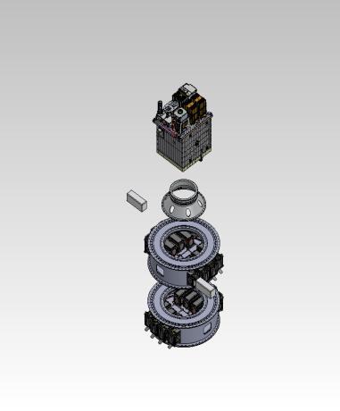
ORS and CubeStack Novel Idea for Multi-Mission Launch
UNCLASSIFIED – CLEARED FOR PUBLIC RELEASE
ORS partnered with AFRL to
develop & produce the CubeStack
Multi CubeSat adapter – “Low Maintenance” tertiary canisterized ride capability
To primary Space Vehicle looks like part of the rocket body
To Launch Vehicle looks like a single Space Vehicle
ORS-3 Mission – Summer 2013 will fly 2 CubeStacks
Largest multi-mission launch using a Minotaur I launch vehicle
As many as 27 space vehicles, tests and demonstrations
Primary Space Vehicle
STPSat-3
2 Separation Signals from LV
Separate Primary
Start Sequencer
24” to 15” Cone
Wafers
(Shown w/PPODS)

Slide 10
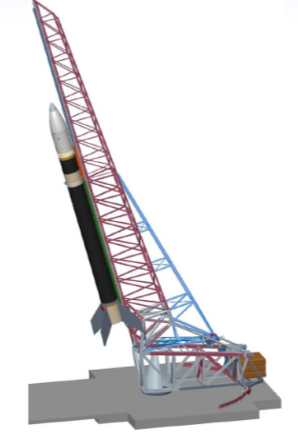
Unclassified Cleared for Public Release
ORS-4: Super Strypi Mission
Demonstrate low-cost launch to LEO
Approach
Apply sounding rocket technologies, methods & practices
Leverage commercial space launch approval processes
Enable technology transfer to commercial vendor
Use demonstration mission to mature rocket, launch rail, CONOPS
Long Term Objectives
300kg/400km/45 degree inclination
$15M fly-away in production
Current Effort Specifics
Launch: late FY13, Pacific Missile Range Facility
Rail launched
Partners:
ORS Office (Mission Manager)
Univ of Hawaii: payload
Sandia National Lab: LV integrator)
Aerojet Corp: motors
PMRF: launch site
Payloads
Univ of Hawaii Hiakasat
Autonomous Flight Safety System
others TBD

Slide 11
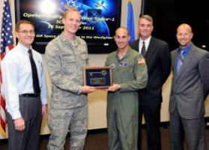

ORS-1 Lessons Learned
Unclassified Cleared for Public Release
ORS-1 proves small satellites have military utility
Refining requirements directly with warfighter results in out-of-the-box solutions that work
A small, agile team is key to executing quickly & efficiently
It is challenging but possible to “go fast in acquisition”
Adequate and stable funding are an absolute necessity
Senior leadership buy-in and advocacy required
Prototyping operational capability more complicated and costly than building S&T experiment
Do not use “technology development” to meet urgent needs
Tailor testing requirements but “test like you fly”
ORS-1 Transitioned to AFSPC and Operated by 1 SOPS
Unclassified Cleared for Public Release

Slide 12

ORS – A National Initiative
Unclassified Cleared for Public Release
ESC
MIT/LL
SDI
DoD EA for Space
NRO / NSA / NGA
NASA / NRL / DARPA
NASA Goddard
JFCC ISR / JTF-GNO
Navy NETWARCOM
APL
USSTRATCOM
NASA Ames
SDL
AFSPC
JFCC SPACE
JPL
LANL
Army/SMDC
NASA MSFC
AFSPC/SMC
NASA
Wallops
NM Spaceport
ORS Office
SMC/SDD
AFRL
SNL
SPAWAR
SPAWAR
CCAFS
NASA KSC
SOUTHCOM
NASA
JSC
CENTCOM
SOCOM
Kodiak Launch
Complex
PMRF
PACOM
UH
Innovation and Integration through Collaboration
Unclassified Cleared for Public Release

Slide 13
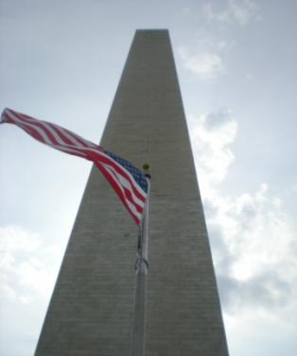

ORS -- Avenue for Innovation
Unclassified Cleared for Public Release
Small satellite systems are technically mature
Fielded quickly (~32 months for ORS-1)
Provide “good enough”, relevant capabilities
Proven with multiple phenomenologies through USCENTCOM’s ORS-1, TacSat-3 and TacSat-4
ORS embraces a flexible business model
Accepting of disruptive innovation
Adaptable, and complementary to the existing NSS architecture
Rapid and cost effective to develop and deploy space capabilities
ORS provides focus for operational advantage
Serves the disadvantaged user
Reduces high demand on existing assets
ORS-1 Wallops Jun 11
TacSat-4 Kodiak Sep 11
Unclassified Cleared for Public Release

